Slide 1
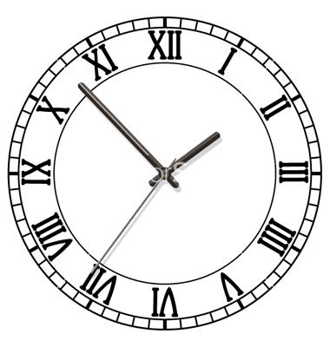
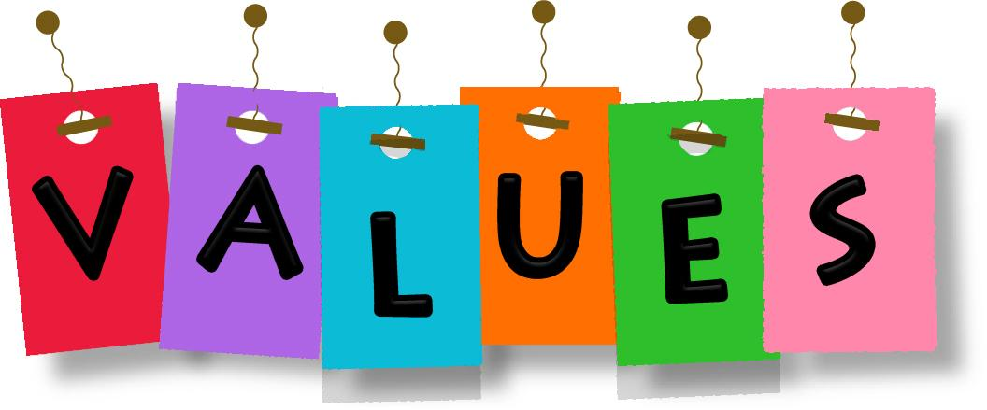
Values and Time Management
Presenters: Kayla Vaughan and Nick Lennon
Active Leaders 2016

Slide 2
Icebreaker :)
Stringing Me Along

Slide 3
Time Management Discussion
Time Management Activity
Values DIscussion
Values Activity
Wrap Up :)
Overview

Slide 4
How Do you keep track of everything?
How well does that work for you?
Time Management

Slide 5
Less Stress and Anxiety
Organization
Completion of Tasks or Goals
Personal Time
Better Physical, Mental, and Emotional Well Being
Benefits of Time Management

Slide 6
Plan it out!
Time Management Activity

Slide 7
“The regard that something is held to deserve, the importance, worth, or usefulness of something” - webster’s Dictionary
What are values?

Slide 8
What is your definition of “Values”
Write your definition on the handout provided

Slide 9
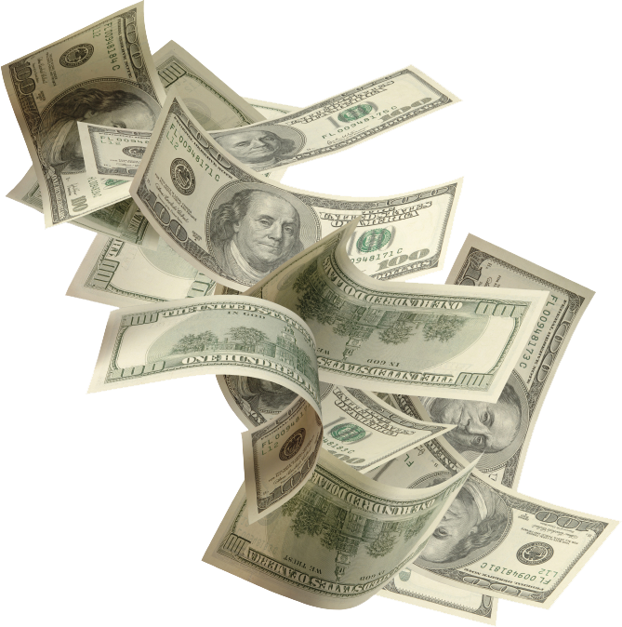
Get your money ready folks…

Slide 10
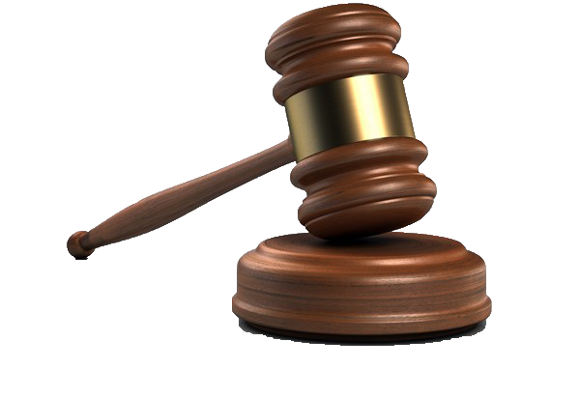
Let the Values Auction BEGIN!

Slide 11
Value NUmber...
1
Self-Confidence

Slide 12
Value NUmber...
2
Giving back to your community

Slide 13
Value Number…
3
Physical Well-Being

Slide 14
Value Number…
4
Knowing your purpose in life

Slide 15
Value Number…
5
Multicultural Awareness

Slide 16
Value Number…
6
Close Friendships and Relationships

Slide 17
Value Number…
7
Personal Reflection Time

Slide 18
Value Number…
8
Making a lot of money

Slide 19
Value Number…
9
Family

Slide 20
Value Number…
10
Personal Happiness

Slide 21
Value Number…
11
Having power and authority

Slide 22
Value Number…
12
Organization

Slide 23
Value Number…
13
Spiritual Beliefs

Slide 24
Value Number…
14
Consistency

Slide 25
Value Number…
15
Being liked, valued, & appreciated by others

Slide 26
Value Number…
16
Leadership

Slide 27
Value Number…
17
Civic Duties

Slide 28
Value Number…
18
Being a role model or mentor to others

Slide 29
Value Number…
19
Career Readiness

Slide 30
Value Number…
20
Education

Slide 31
PUT THOSE VALUES TO WORK :)

