Slide 1
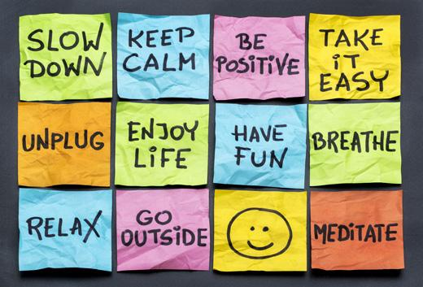
Self-Care
Active Leaders 2016
Kayla Vaughan and Nicholas Lennon

Slide 2
Icebreaker!

Slide 3
Overview of the day:
What is Self Care discussion
Self-Assessment
Let’s share!
Help me, help you!
Creativity corner!

Slide 5
Oprah on Self-Care

Slide 7
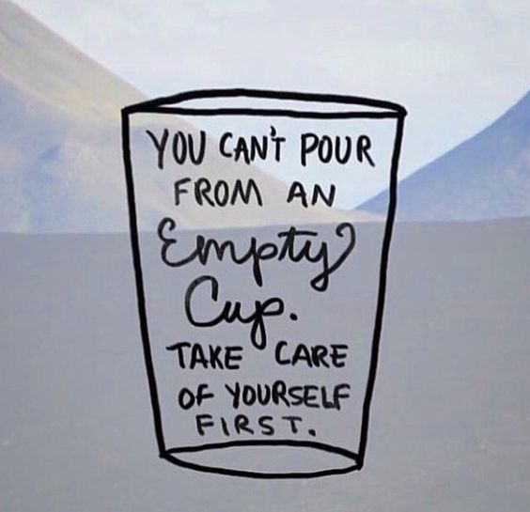

Slide 8
Self-Assessment!

Slide 9
Let’s share!

Slide 10
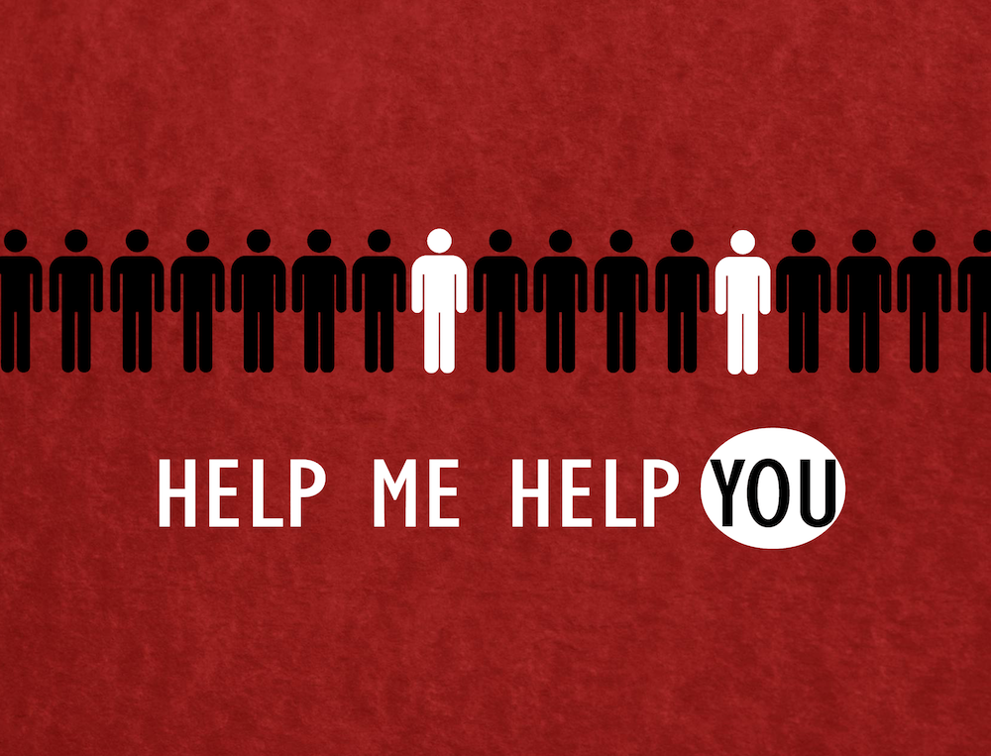

Slide 12
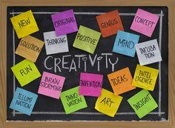
Creativity Corner!

